Slide 1
Vio.PY output
Pages 2: Trace of Covariance Matrix Plot
Page 3: Attitude/Position/Velocity Plot
Page 4: Accelerometer/Gyrometer Plot
Page 5: Gravity Plot
Page 6: Observations
Ikenna Achilihu
MEAM 620, Spring 2021
Project II phase III

Slide 2
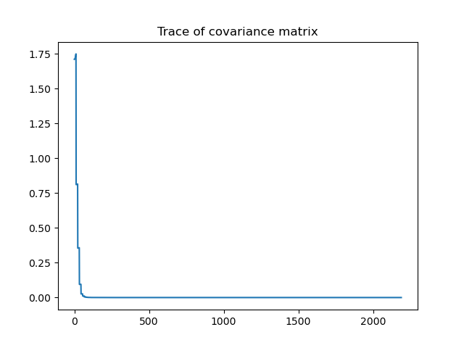

Slide 3
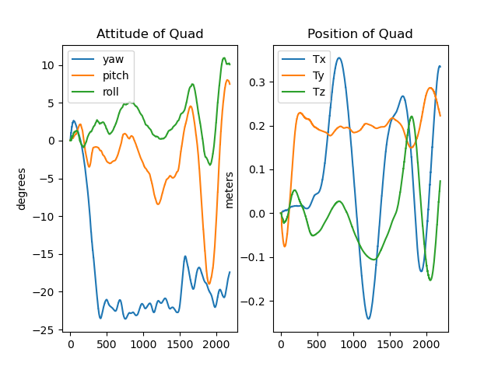
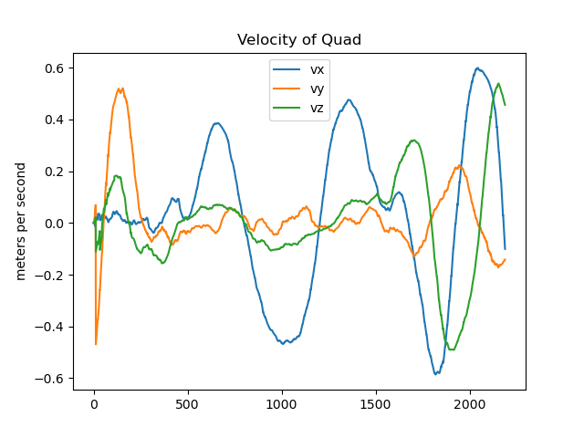

Slide 4
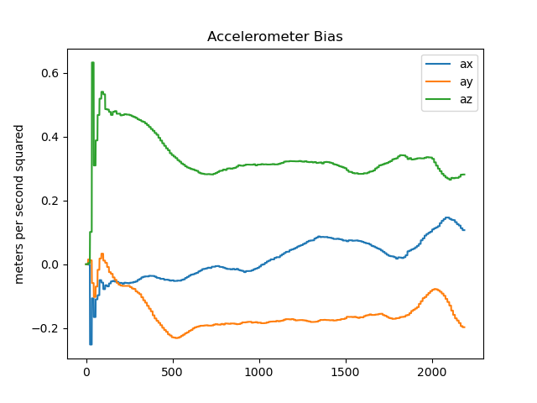
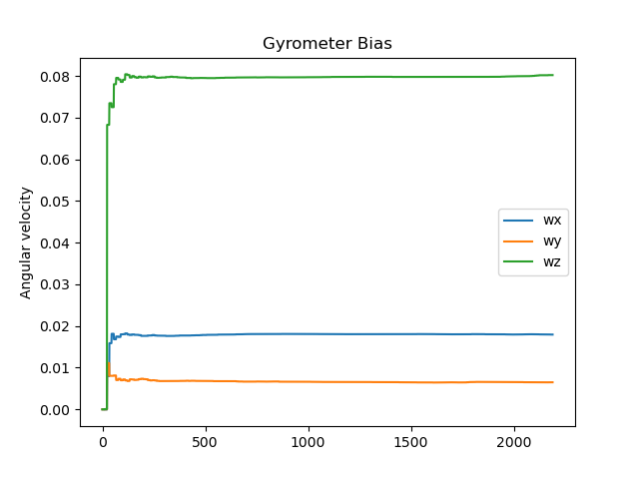

Slide 5
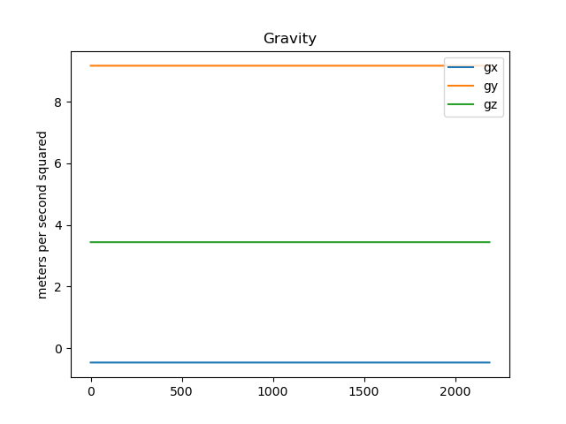

Slide 6
Looking at the accelerometer bias plots, we note the presence of a bias which varies with time, a result that is indeed expected. Furthermore, after generating a video file from the 600 images present in cam0 and cam1 and comparing the resulting video to the estimated pose and trajectory from our Kalman Filter algorithm, we observe several areas of congruence. Note that the first ~3.5 minutes of each video were relevant because we only plotted the first 200 images. In each video, we observe the quadrotor’s x-axis position varying sinusoidally, with its magnitude varying much more than the z-axis position, an observation that is supported in our plots.. This corresponds to the equadrotor executing a circular motion which was captured by the cameras. Y-axis variation remains relatively constant which is also bolstered by our plots.

